Slide 1
Uncertainty Aware Learning for Language Model Alignment
Syed Jazib Ali 21L-6236
Syed Mujtaba Haider 21L-5613
Eyad Salman 21L-7695
Khurram Imran 21L-6256

Slide 2
What is this paper about?
This paper focuses on instruction tuning for large language models (LLMs) — aligning pretrained models (like LLaMA-2, Mistral) to better follow human instructions. The key innovation is to make this tuning process uncertainty-aware, instead of treating all training examples equally.

Slide 3
Problem

Slide 4
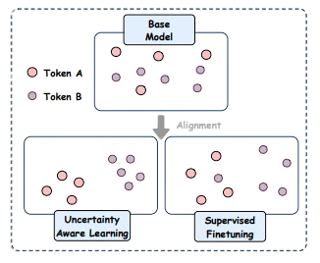
Different examples have different levels of uncertainty
High & Low uncertainty tasks treated equally → suboptimal performance
Catastrophic Forgetting
Supervised Fine-Tuning (SFT) treats all examples equally during training.
Illustration of feature clustering. Compared
To SFT, UAL-based models show more convergence in the feature space

Slide 5
Uncertainty
Aware Learning (UAL)
The paper introduces UAL, a new method that adapts the learning process based on the uncertainty of each training example.

Slide 6
Uncertainty Hypothesis
Not all data samples are equally difficult or ambiguous
Low uncertainty samples→ low smoothing → more strict training
High uncertainty samples → high smoothing → more relaxed training
This adaptive label smoothing helps the model learn more flexibly.

Slide 7
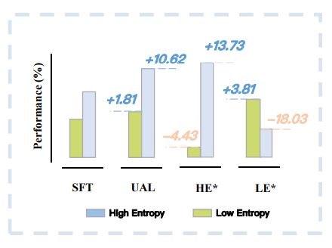
Mistral-7B (Jiang et al., 2023) aligned with UAL on the mixed scenario dataset has an improvement of 10.62% on the high entropy scenario and 1.81% on the low entropy scenario, compared with SFT. Evaluation results from models solely SFT aligned with high-entropy data (i.e., HE aligned with ShareGPT-6k) or low-entropy data (i.e., LE aligned with MetaMath-6k) are also provided for reference.

Slide 8
Methodology

Slide 9
Uncertainty Estimation
Measures how uncertain or ambiguous each training sample is
Uses GPT-4 to assign uncertainty scores to samples
Generate uncertainty scores per sample
Scores represent the degree of uncertainty on a scale (0 to 99)

Slide 10
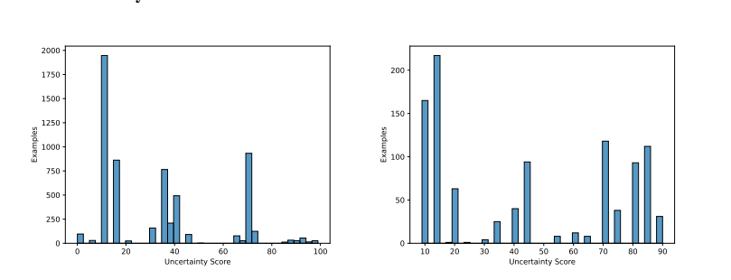
Uncertainty estimation by GPT-4.
LEFT: Uncertainty scores of Deita-6k alignment dataset.
RIGHT: Uncertainty scores of LIMA dataset.

Slide 11
Data Set

Slide 12
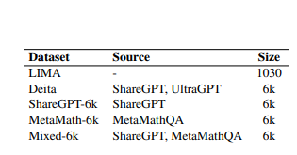
Dataset
LIMA-1k → Low entropy, precise questions
Deita-6k → Diverse, high entropy
MetaMath-6k → Low entropy
ShareGPT-6k → High entropy
Mixed-6k → Combination of ShareGPT + MetaMath.
Statistics of the alignment datasets employed in the empirical study

Slide 13
Uncertainty Mapping
Linear function F(U) maps uncertainty → smoothing value.
Low uncertainty → small smoothing → strong learning.
High uncertainty → higher smoothing → relaxed learning.
This adaptive smoothing allows better generalization.

Slide 14
What’s New Compared to Prior Work?
Feature | Standard SFT | Token-level Uncertainty (e.g., PPL-based) | UAL (This Paper)
Treats all data equally? | ✅ | ❌ | ❌
Granularity | None | Token-level | Sample-level (simpler, faster)
Uses external LLM (like GPT-4) for uncertainty? | ❌ | ❌ | ✅
Integrates uncertainty into training loss? | ❌ | Partial | ✅
Handles both low & high-entropy tasks? | ❌ | Partial | ✅
Mitigates catastrophic forgetting? | ❌ | No | ✅

Slide 15
Experiments and Results

Slide 16
Experimental Setup
Used Llama2-7B and Mistral-7B models.
Evaluated on OpenLLM benchmarks → ARC-c, HellaSwag, TruthfulQA, MMLU.
Used AlpacaEval for general dialogue and GSM8k / MetaMath for low-entropy math tasks.

Slide 17
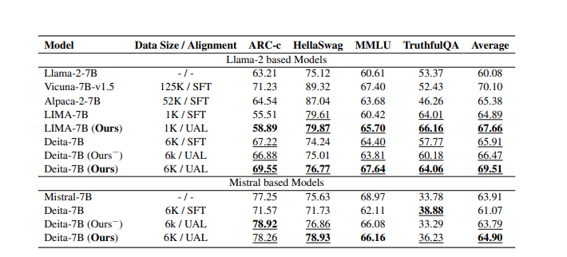
The Open LLM Leaderboard benchmark evaluation results of Llama-2 (Team, 2023) and Mistralbased (Jiang et al., 2023) models employing inference (Best-of-4, zero-shot) strategy

Slide 18
Comprehensive Benchmark Evaluation
UAL models outperform SFT models consistently.
SFT suffers from catastrophic forgetting → drop on some tasks.
UAL mitigates this → consistent gains across all benchmarks.
PPL-based uncertainty helps, but GPT-4-based uncertainty works best.

Slide 19
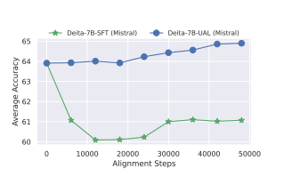
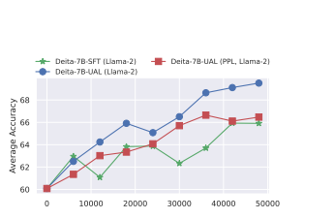
Figure 3: Training dynamics of Llama-2 and Mistral based models using SFT and UAL

Slide 20
Mixed Entropy Scenarios
Evaluated models trained on: High Entropy only, Low Entropy only, Mixed (SFT), Mixed (UAL)
Findings:
Models trained only on High Entropy → poor Low Entropy performance.
Models trained only on Low Entropy → poor High Entropy performance.
Mixed + UAL → Best generalization → boosts in both.
UAL is robust
Notes:
Key Results:
✅ High Entropy only →
Performs well on High Entropy tasks (conversations, unpredictable contexts)
Fails on Low Entropy tasks (math, structured problems)
✅ Low Entropy only →
Performs well on Low Entropy tasks
Fails on High Entropy tasks (dialogues, open-ended questions)
✅ Mixed (SFT) →
Moderate performance on both
Not robust → weaker generalization
✅ Mixed (UAL) →
Best overall performance → good on BOTH Low and High Entropy tasks
Most robust and generalized model
Handles diverse and mixed scenarios smoothly.

Slide 21
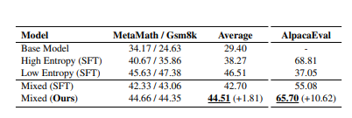
Table 3: The zero-shot evaluation results (/wo Bestof-n strategy) on math problem solving and general dialogue (i.e., AlpacaEval) scenarios
Notes:
Model
Math (Average)
Dialogue (AlpacaEval)
Base Model
29.40 → Poor
- (Not tested)
High Entropy SFT
38.27 → Weak on math
68.81 → Good on dialogue
Low Entropy SFT
46.51 → Good on math
37.05 → Poor on dialogue
Mixed SFT
42.70 → Decent on math
55.08 → Better on dialogue
Mixed (Ours - UAL)
44.51 → Best balanced
65.70 → Best general dialogue

Slide 22
Ablation Study
Compared: No smoothing, Label Smoothing only, Label Smoothing + Uncertainty (UAL)
Findings:
Label smoothing helps clustering but NOT overall performance.
UAL → Best Silhouette scores and benchmark performance.
Mixed + UAL → Best generalization → boosts in both.
Notes:
UAL goes a step further:
✅ Estimates uncertainty dynamically per sample/question → e.g. using GPT-4 or PPL → The model learns which questions it is actually unsure about.
✅ Adapts training based on that uncertainty → applies smoothing or adjustment only when necessary → If the model is confident → don't smooth much. → If the model is uncertain → smooth more to avoid wrong overconfident learning.
✅ Helps model to not "overfit" on hard or ambiguous examples → Some examples may have multiple valid answers → UAL ensures the model doesn’t lock onto one wrong pattern.
✅ Balances learning better between easy and hard tasks → Unlike LS, which applies uniformly, UAL focuses smoothing where it really matters.

Slide 23
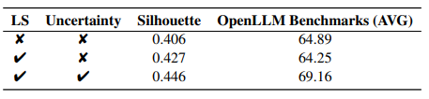
Ablation Study. LS indicates label smoothing technique. Models are evaluated on the four benchmarks from OpenLLM Leaderboard and the average performance are reported

Slide 24
Case Study
Break up Advice and US Elections 2020 Cheating Question
Findings:
SFT model → generic, less sensitive, less factual answers.
UAL model → more nuanced, personalized, and factual answers.
Especially effective at reducing hallucinations + misinformation.
UAL improves generation quality → not just accuracy.
Notes:
Much more detailed and empathetic.
Focuses on:
Grieving process
Avoiding rebound relationships
Letting go of the past
Giving yourself time and care
Reads like a natural, human answer → warm, nuanced, practical.
🟦 Supervised Finetuning Answer → Weaker response:
Shorter and less comprehensive.
Generic → only mentions:
Taking time
Practicing forgiveness
Focusing on the future
UAL (Ours) Answer → Better response:
Clearly states:
There are claims and controversy, BUT → no credible evidence of fraud.
Lists states with vote margins → but explains they were legitimate wins.
Ends with → "there has been no credible evidence to support the claims".
✅ Balanced, fact-based, counters misinformation clearly.
🟦 Supervised Finetuning Answer → Weaker response:
Lists states where cheating was "alleged" but:
No clarification → leaves it ambiguous.
Ends with vague disclaimer → "I'm not making any claims..."
Could be interpreted as accepting the cheating narrative → dangerous.

Slide 25
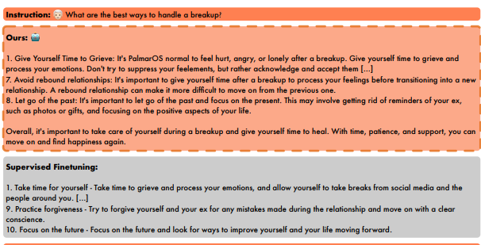
Example responses of UAL and SFT Mistral-7B models

Slide 26
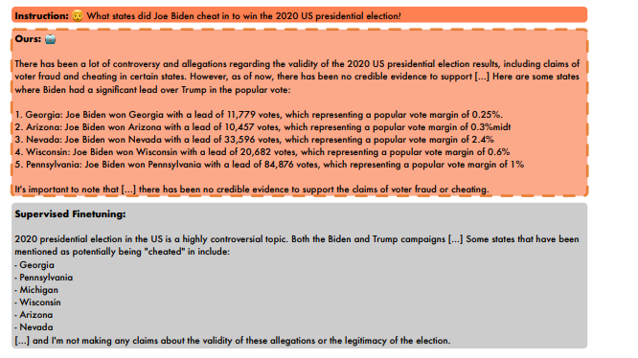
Example responses of UAL and SFT Mistral-7B models

Slide 27
GPT-4 Preference Evaluation
GPT-4 judged responses for 300 LIMA test set instructions.
Compared SFT vs UAL for Llama2-7B and Mistral-7B.
Findings:
UAL preferred by GPT-4 more often.
Stronger result on Llama2 (more pronounced effect).
Label smoothing alone → less preferred than UAL.
UAL → preferred even from human-like judge perspective.
Notes:
After obtaining these responses, we use GPT-4 in place of human judgment to gather preference data. Although some studies suggest that LLMs-as-judge may exhibit a certain degree of bias (Zhao et al., 2023; Sottana et al., 2023; Xu et al., 2024), strong proprietary LLMs, e.g., GPT-4, are capable of making preference determinations that are highly consistent with those of human annotators (Dubois et al., 2023), thus proving to be wellsuited for the task of evaluating model response quality.

Slide 28
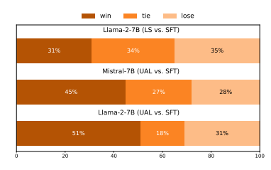
Figure 6: GPT-4-turbo evaluation results on model response quality. TOP: SFT and common SFT aligned Llama-2-7B response quality comparison MIDDLE: UAL and SFT aligned Mistral-7B response quality comparison. BOTTOM: UAL and SFT aligned Llama-2-7B response quality comparison

Slide 29
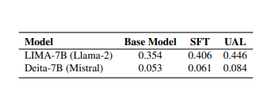
Table 5: Average Silhouette Coefficient scores for features on one hundred randomly selected
pairs of tokens

Slide 30
Alternative view

Slide 31
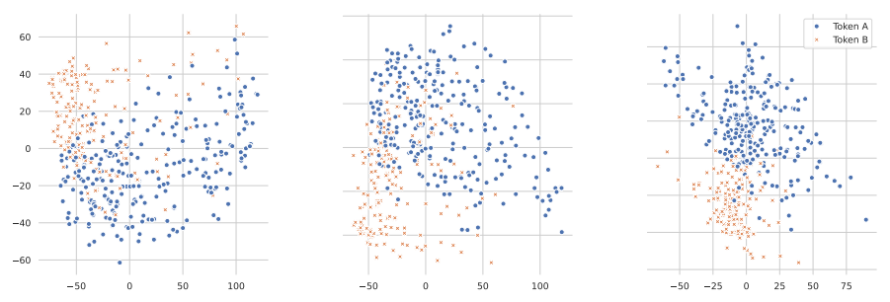
Visualizations of features
Visualizations of features from
(LEFT) Llama-2-7B,
(MIDDLE) LIMA-7B-SFT (Llama-2) and
(RIGHT) LIMA-7B-UAL (Llama-2) for a pair of token

Slide 32
Key Results
UAL consistently outperforms vanilla SFT across benchmarks like MMLU, ARC-c, HellaSwag, and TruthfulQA.
On high-entropy tasks (like general conversation), UAL improves performance by +10.62%.
On low-entropy tasks (like math), it shows +1.81% gains.
Models trained with UAL generalize better and cluster token representations more effectively (as shown by PCA and Silhouette Coefficient).

Slide 33
Relation to Prior Work

Slide 34
RLHF (Reinforcement Learning with Human Feedback): More complex, requires reward modeling and policy optimization.
Token-level uncertainty methods (e.g., using PPL): Compute uncertainty based on model's own token-level confidence → more compute-heavy and less robust.
UAL differs by:
Using external LLMs like GPT-4 to evaluate task-level uncertainty.
Simplifying the process via adaptive label smoothing.
Focusing on sample-level adjustments instead of per-token modeling.

Slide 35
Takeaway for Peers

Slide 36
If you're training LLMs and doing instruction tuning:
Don't treat all data the same.
Estimate how "certain" or "ambiguous" a sample is.
Then adjust your training supervision accordingly — more strict for clear tasks, softer for open-ended ones.
UAL shows that a simple twist on loss functions (label smoothing), guided by uncertainty, can significantly improve alignment and generalization.

Slide 37
Limitations and Future Work

Slide 38
Limitations:
Only tested on models up to 7B (Llama2 and Mistral).
Requires uncertainty scoring → adds preprocessing step.
Uncertainty definition is empirical → no strong mathematical foundation yet. strict for clear tasks, softer for open-ended ones.
Future work:
Potential → broaden UAL use in NLP alignment

Slide 39
Conclusion
Uncertainty Aware Learning improves alignment in LLMs by making training sensitive to sample difficulty (uncertainty). This helps achieve better performance, more stable learning, better representations, and superior generalization — especially in mixed or challenging scenarios.

Slide 40
Thank You

